Slide 1
Genetic variations of Plasmodium falciparum circumsporozoite protein and the impact on interactions with human immunoproteins and malaria vaccine efficacy
Cheikh Cambel Dieng, Colby T. Ford, Anita Lerch, Dickson Doniou, Jennifer Huynh, Kovidh Vegesna, Jun-tao Guo, Daniel Janies, Liwang Cui, Linda Amoah, Yaw Afrane, and Eugenia Lo
https://doi.org/10.1016/j.meegid.2023.105418

Slide 2
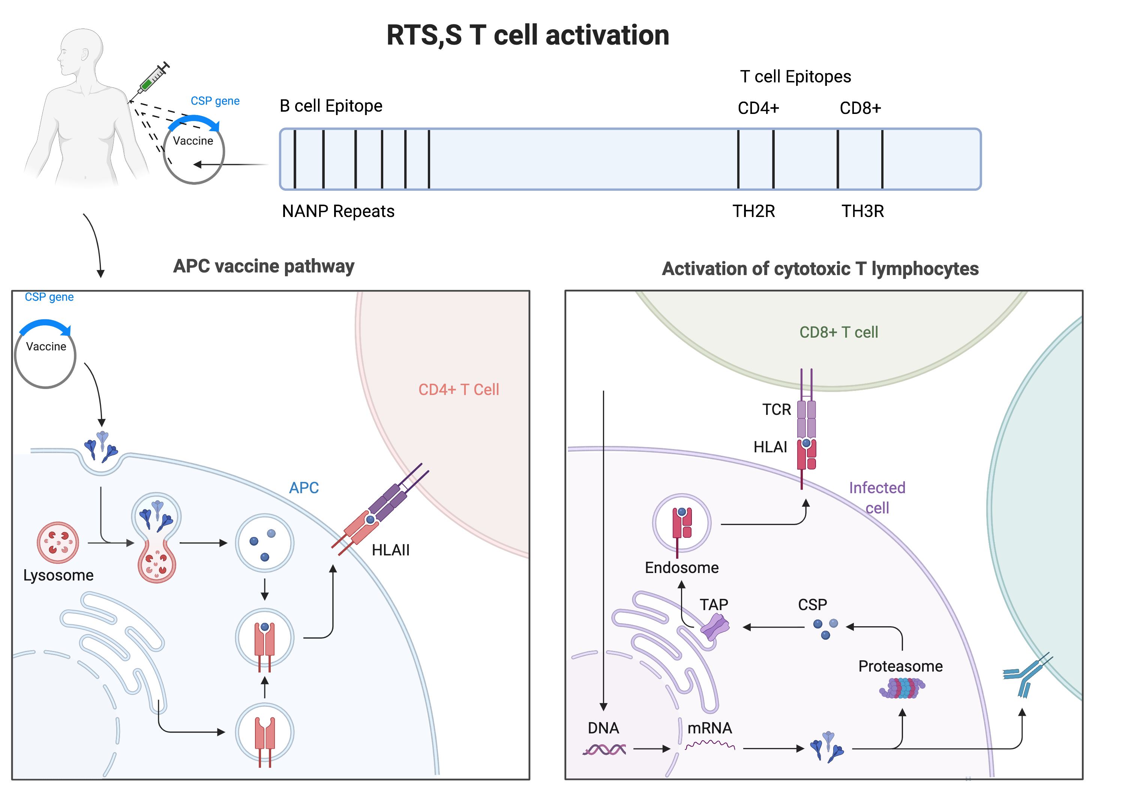

Slide 3
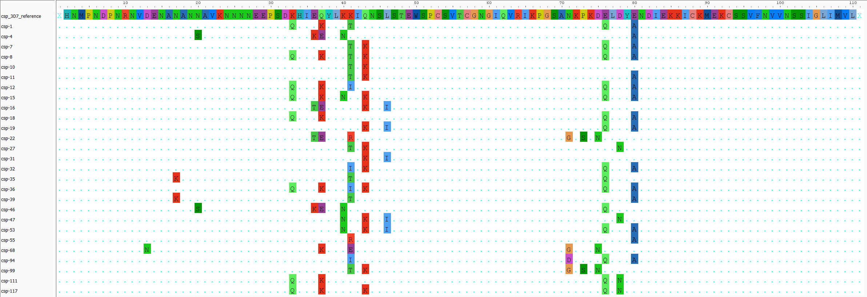
The Problem
Vaccine Efficacy Woes
CD4+
CD8+
The RTS,S vaccine, in Ghana, has a low efficacy (~30%).
The RTS,S vaccine is based on the Plasmodium falciparum 3D7 reference Circumsporozoite Surface Protein (PfCSP).
None of our Ghanaian isolates (haplotypes) matched 3D7.
See where I’m going with this?
HLA-II
HLA-I
Lysosomal
Degradation
Proteasomal
Degradation
Th2R
Th3R

Slide 4

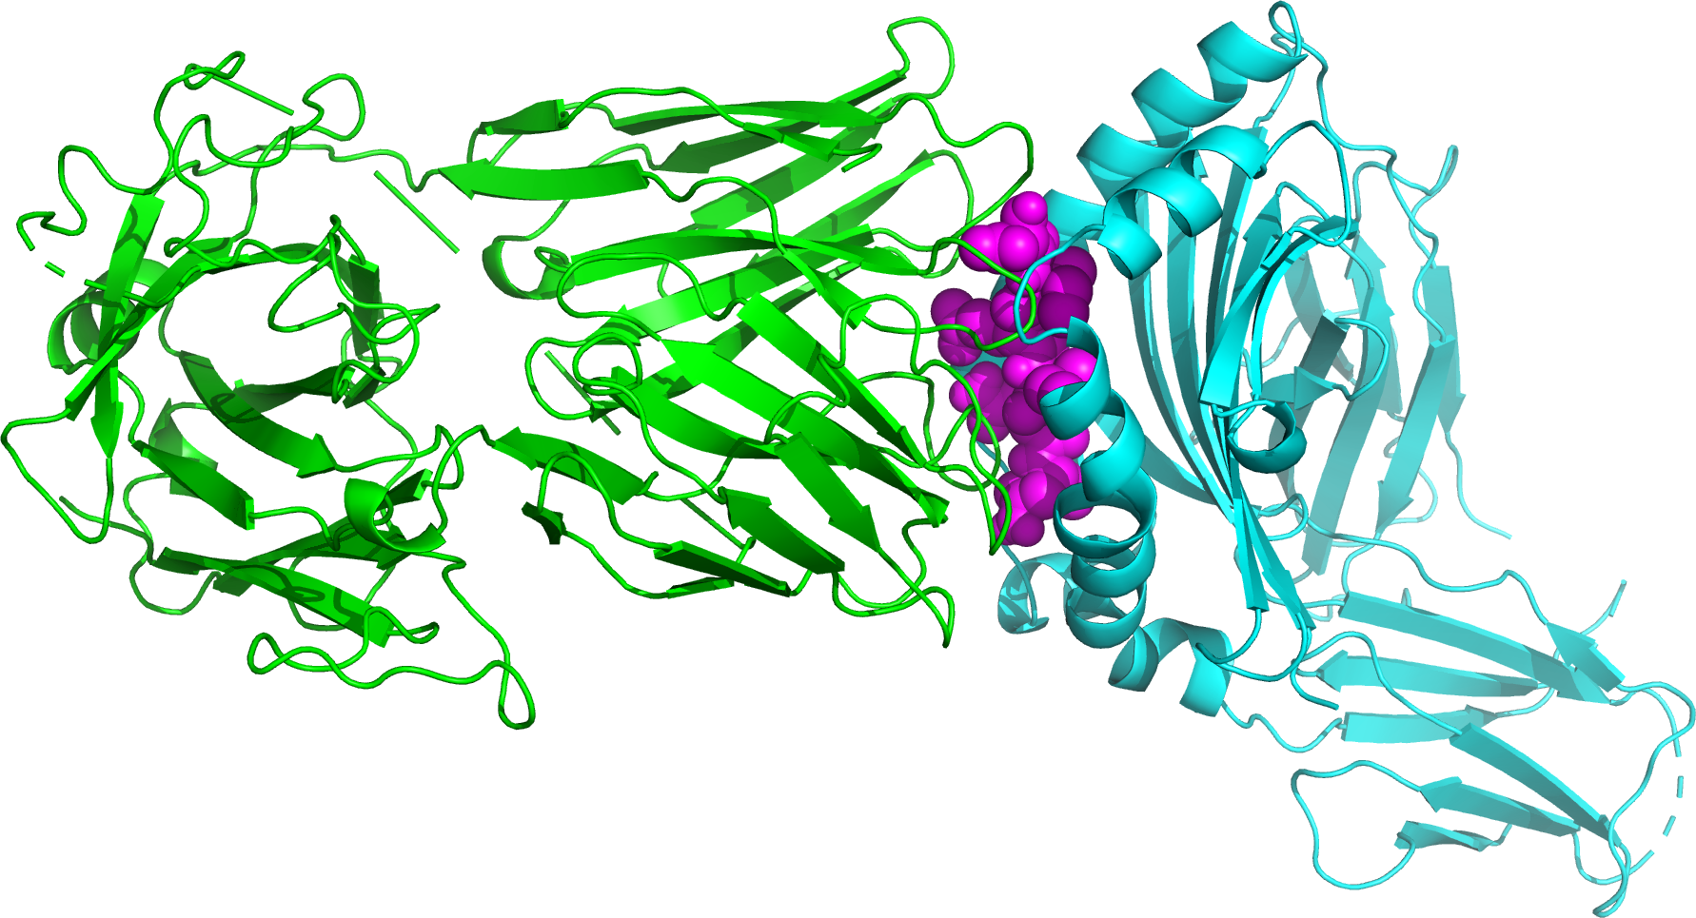
Our Investigation
Find
SNP-based Haplotypes
Filtering and Alignment
CSP Haplotype:
CSP Peptide:
Find CSP Haplotypes
(using HaplotypR)
Filter CSP Haplotypes
Append Reference Sequence
Align Haplotypes to Reference
Docking:
Simulate Degradation and Predict Structure
Protein-Protein Interaction, Docking, and Comparison
TCR
CSP
HLA
Predict CSP haplotype
peptide structures
(using NetChop and PeptideBuilder)
Predict binding affinity between
HLA, CSP peptide, and TCR
(using HADDOCK) and compare

Slide 5
Full Workflow
Preprocess Sequences
Call
Length-Polymorphic Haplotypes
Call
SNP-based Haplotypes
Filtering, Alignment, and Tree Generation
Process Markers
Find MSP-1 Haplotypes
Find CSP Haplotypes
Filter MSP-1 & CSP Haplotypes
Merge Amplicon Reads
(using NGmerge)
Append Reference Sequences
Align Haplotypes to References
Generate Haplotype Trees
Structural Prediction
Protein-Protein Interaction
Interaction Comparison
Predict CSP haplotype structures
(using QUARK)
Predict binding affinity between
CSP, HLA, and TCR
(using HADDOCK)
Quantify binding affinity changes due to
mutations in haplotypes

Slide 6
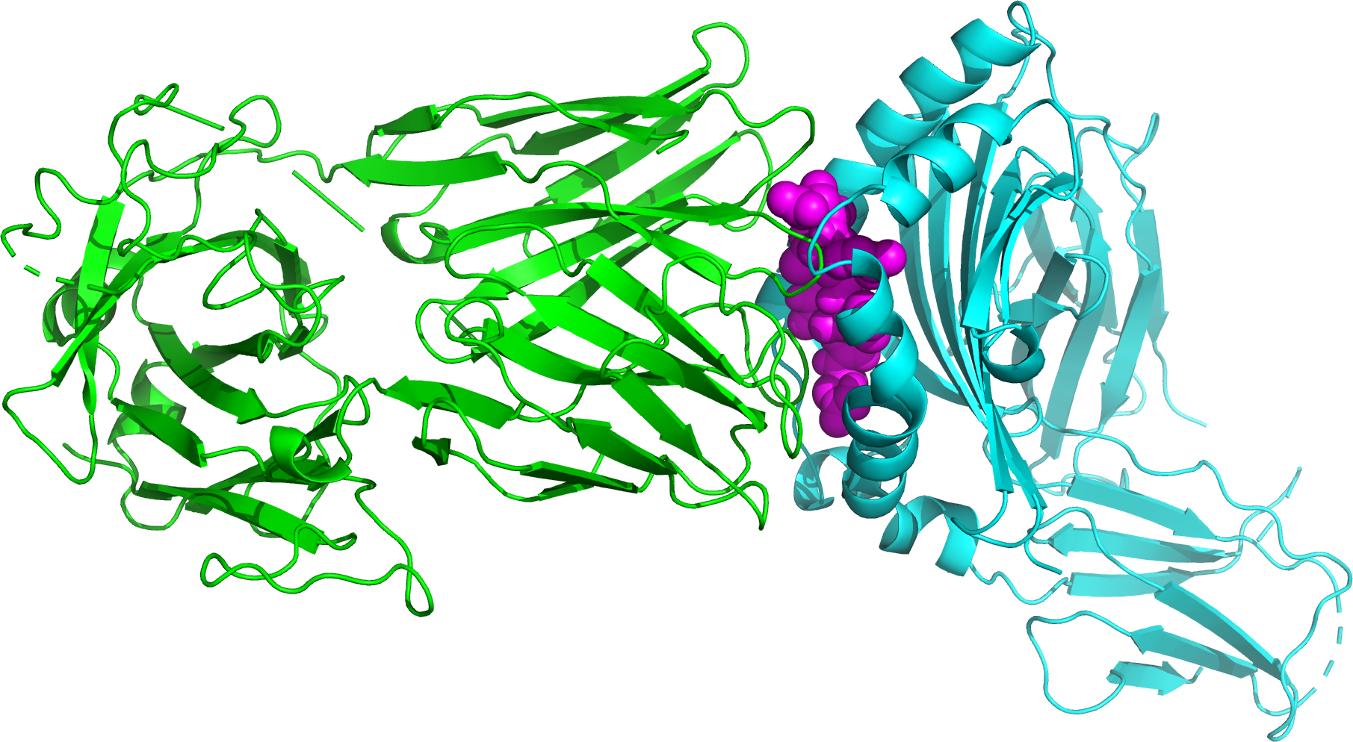
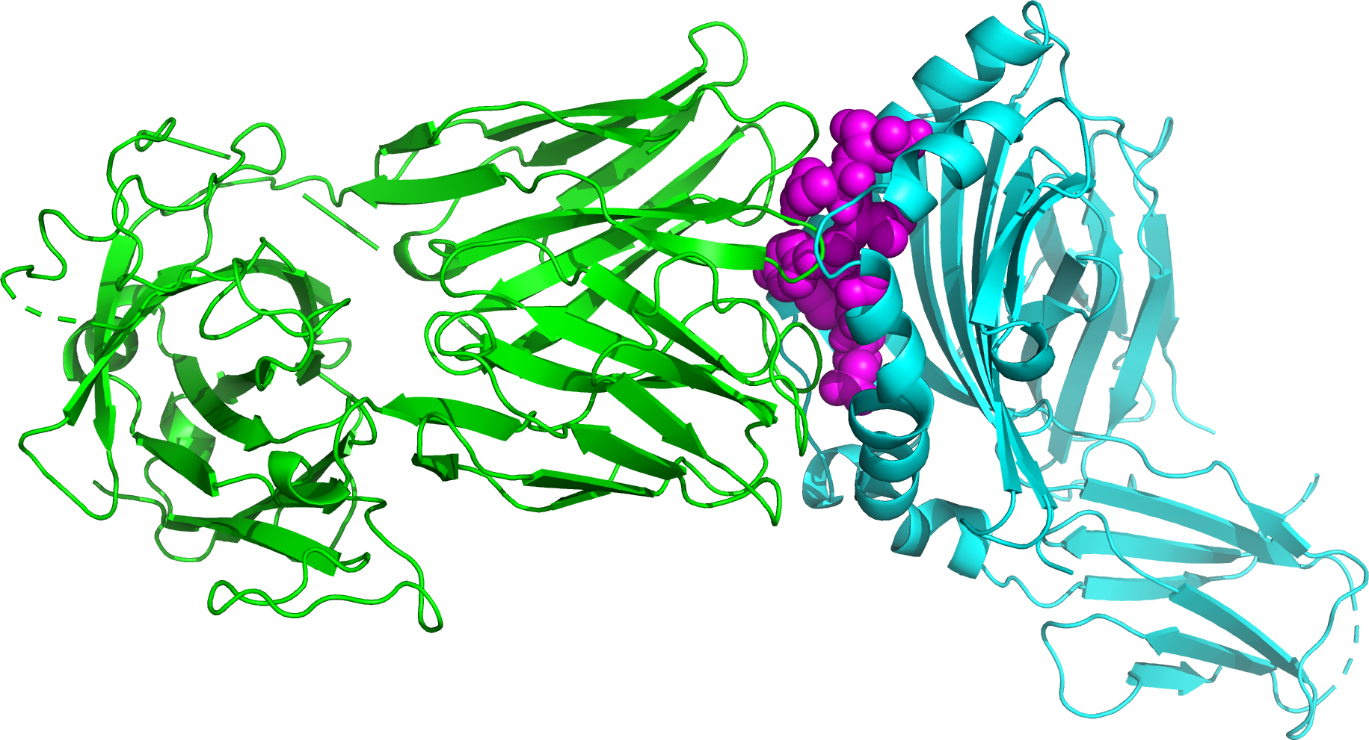
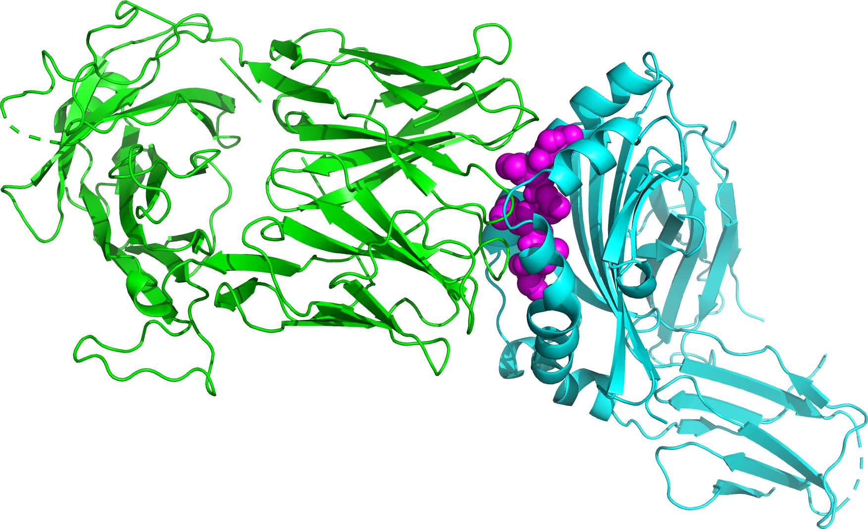
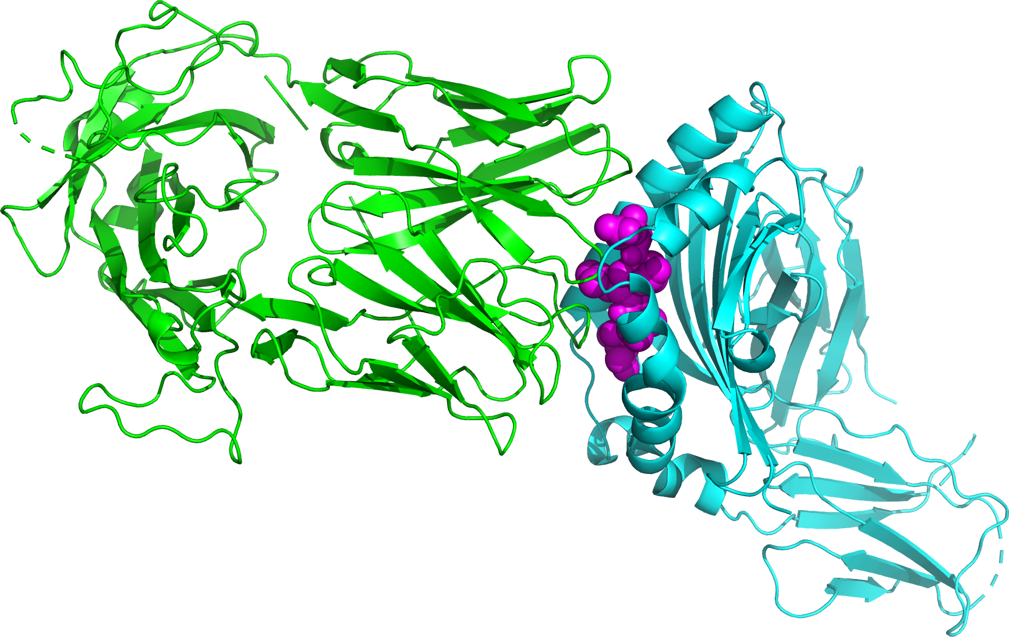
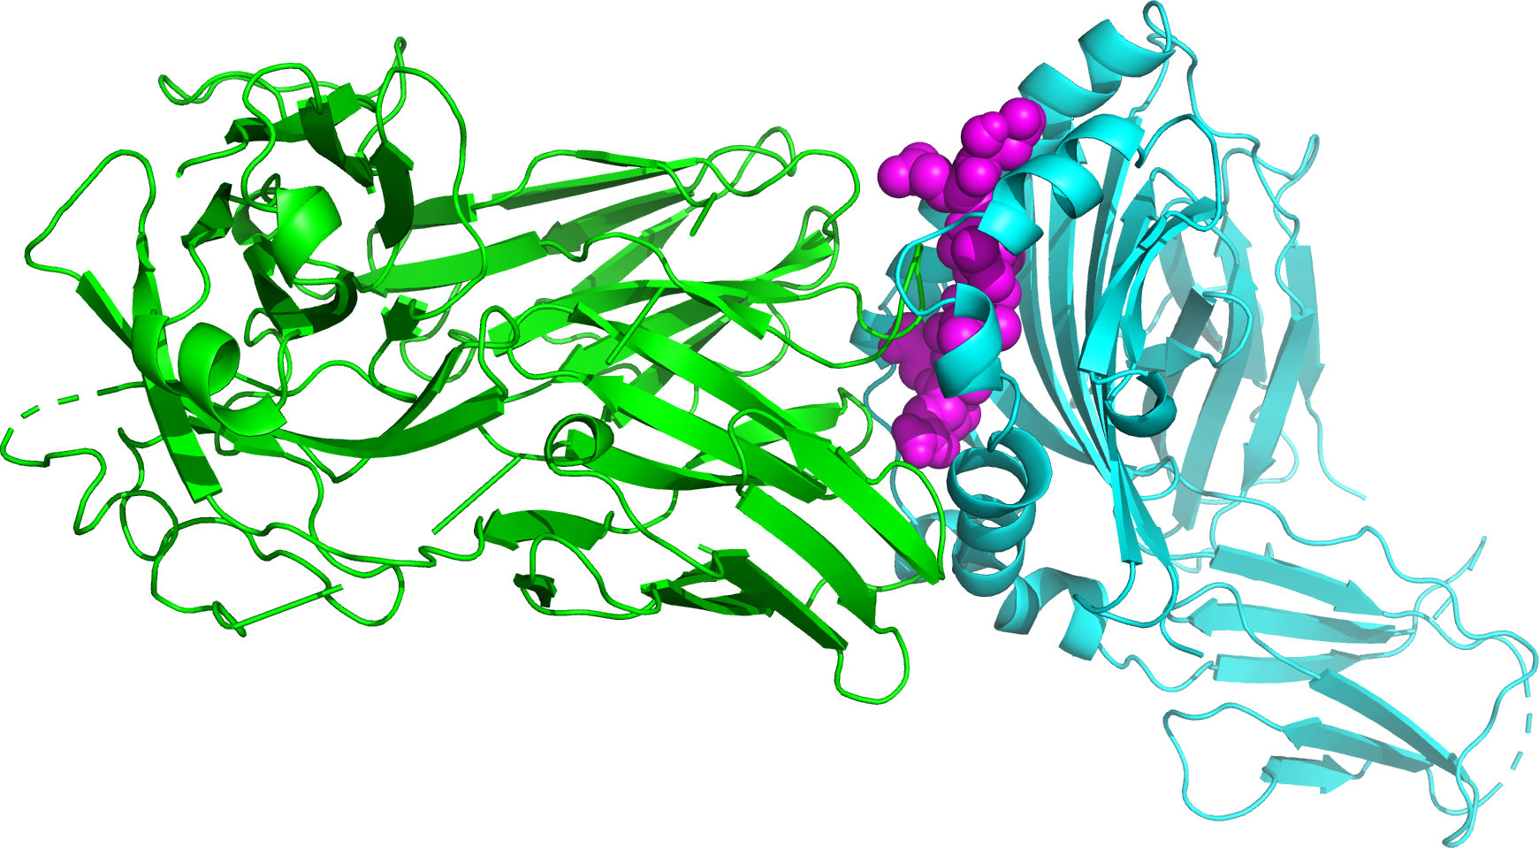
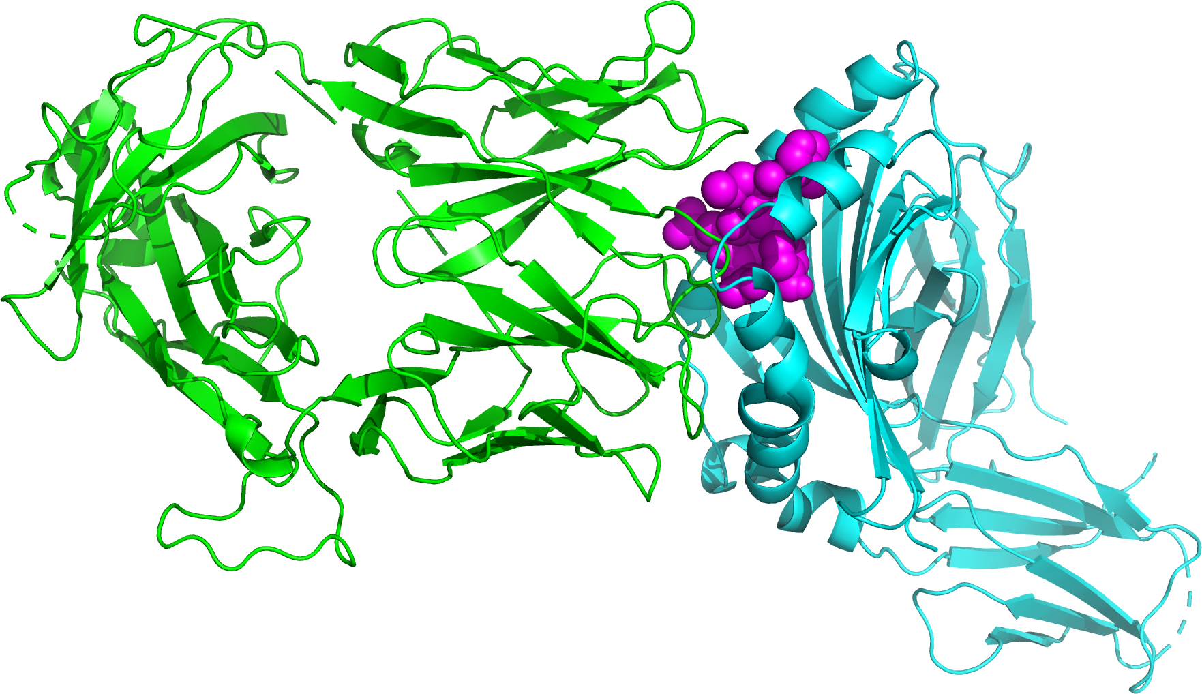
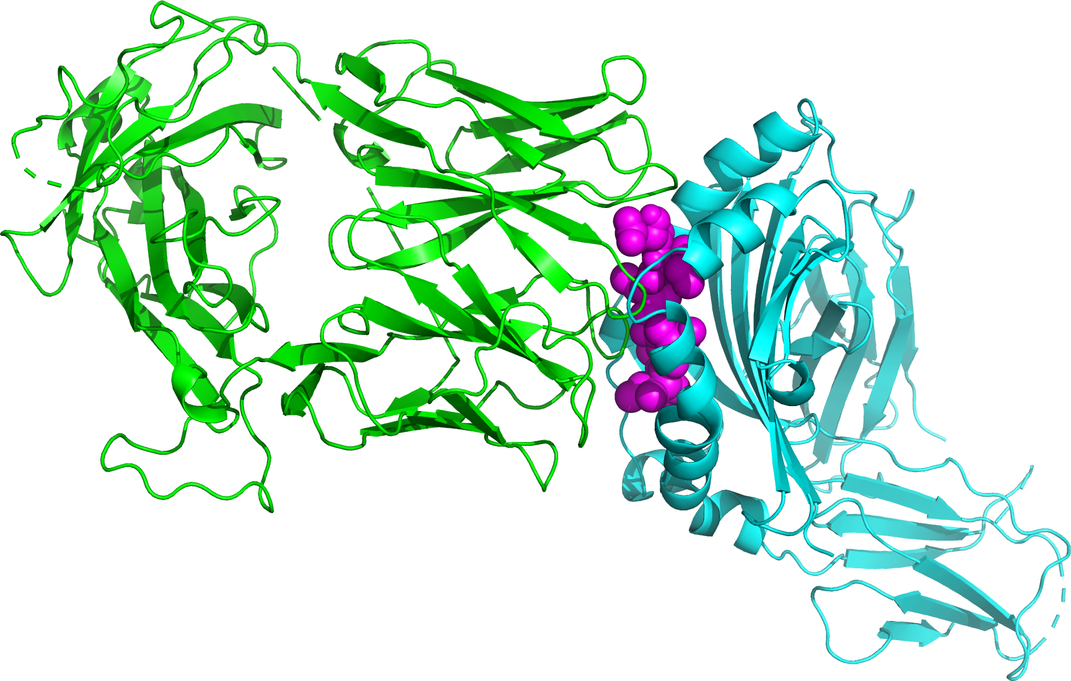
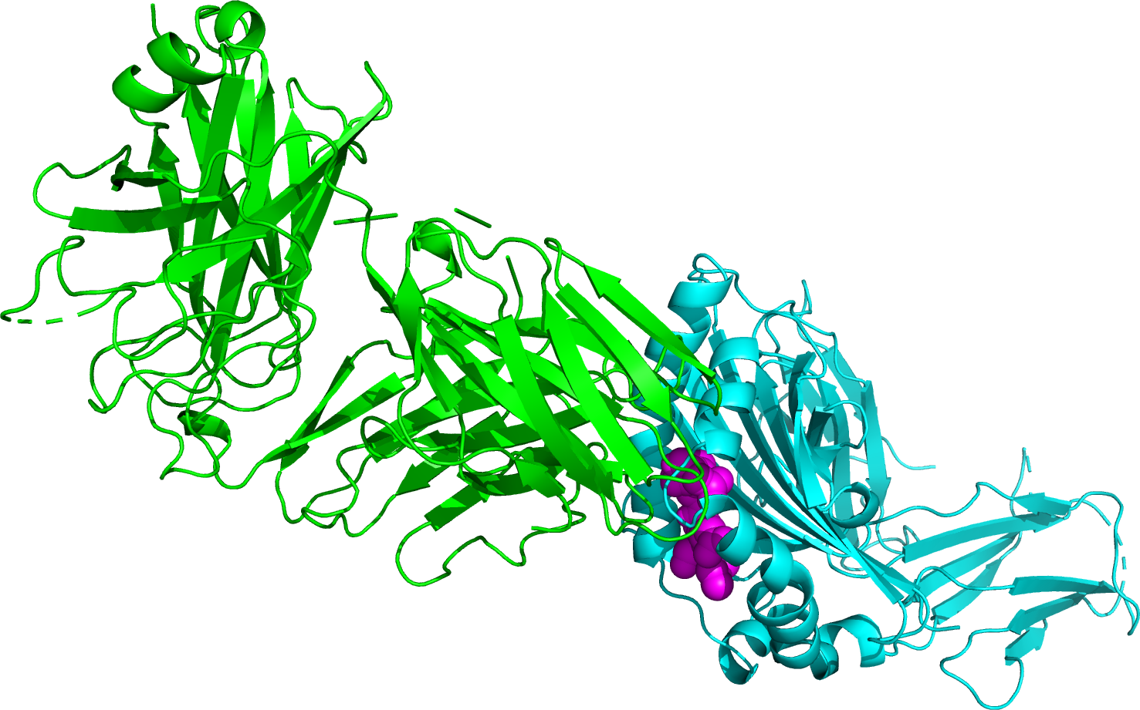
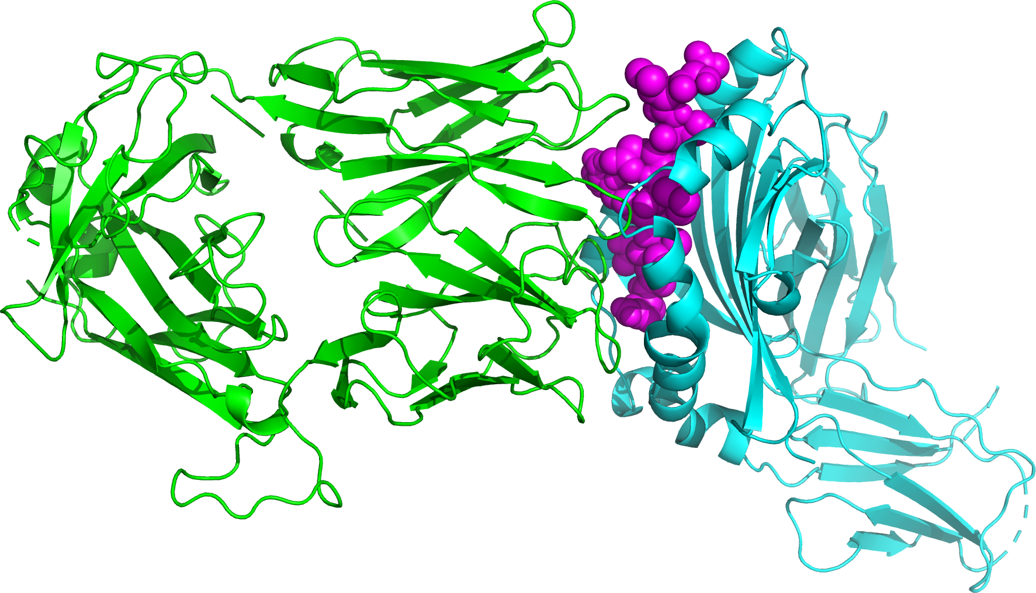
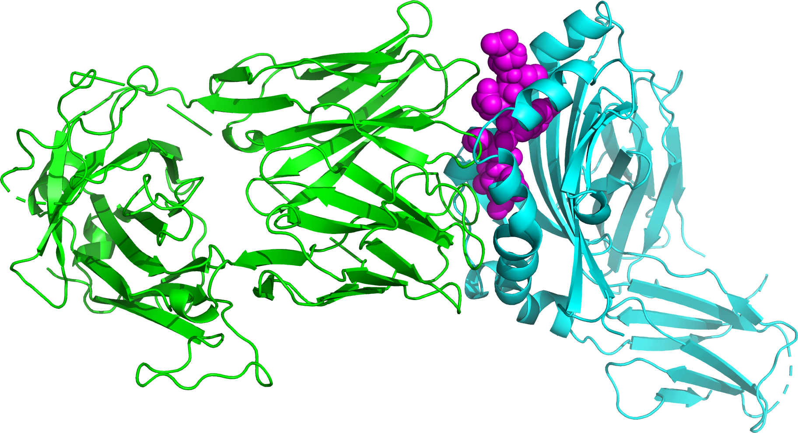
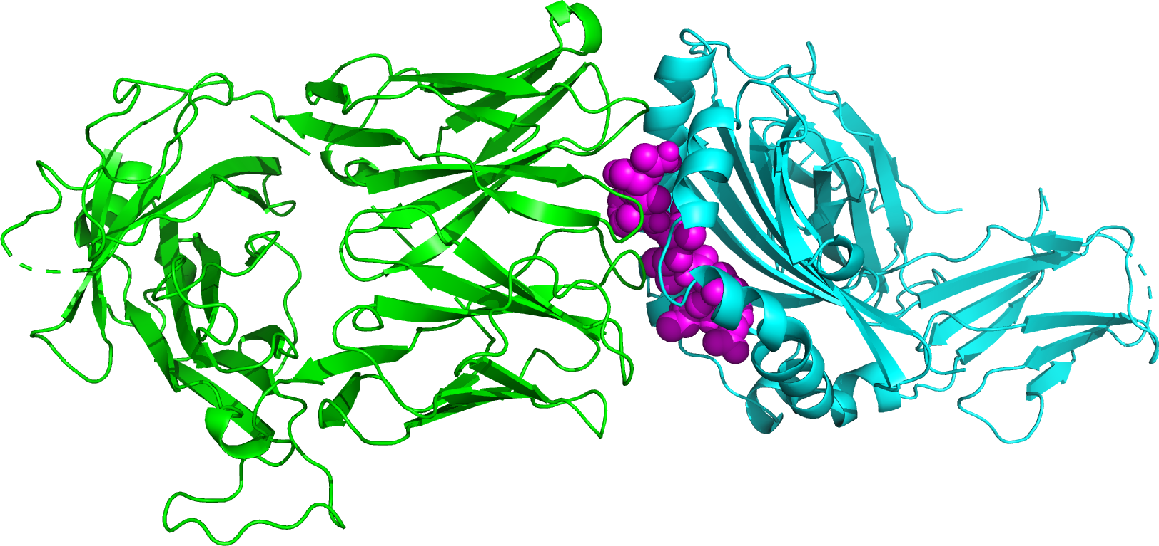

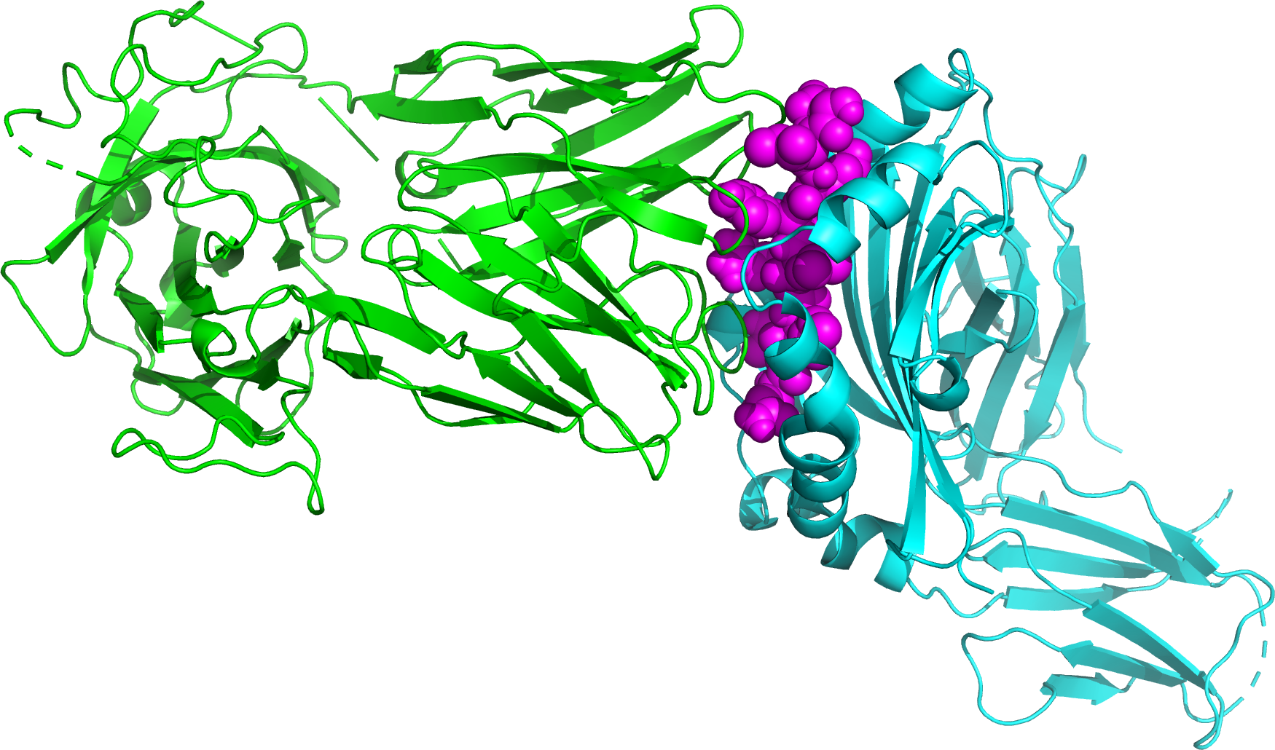

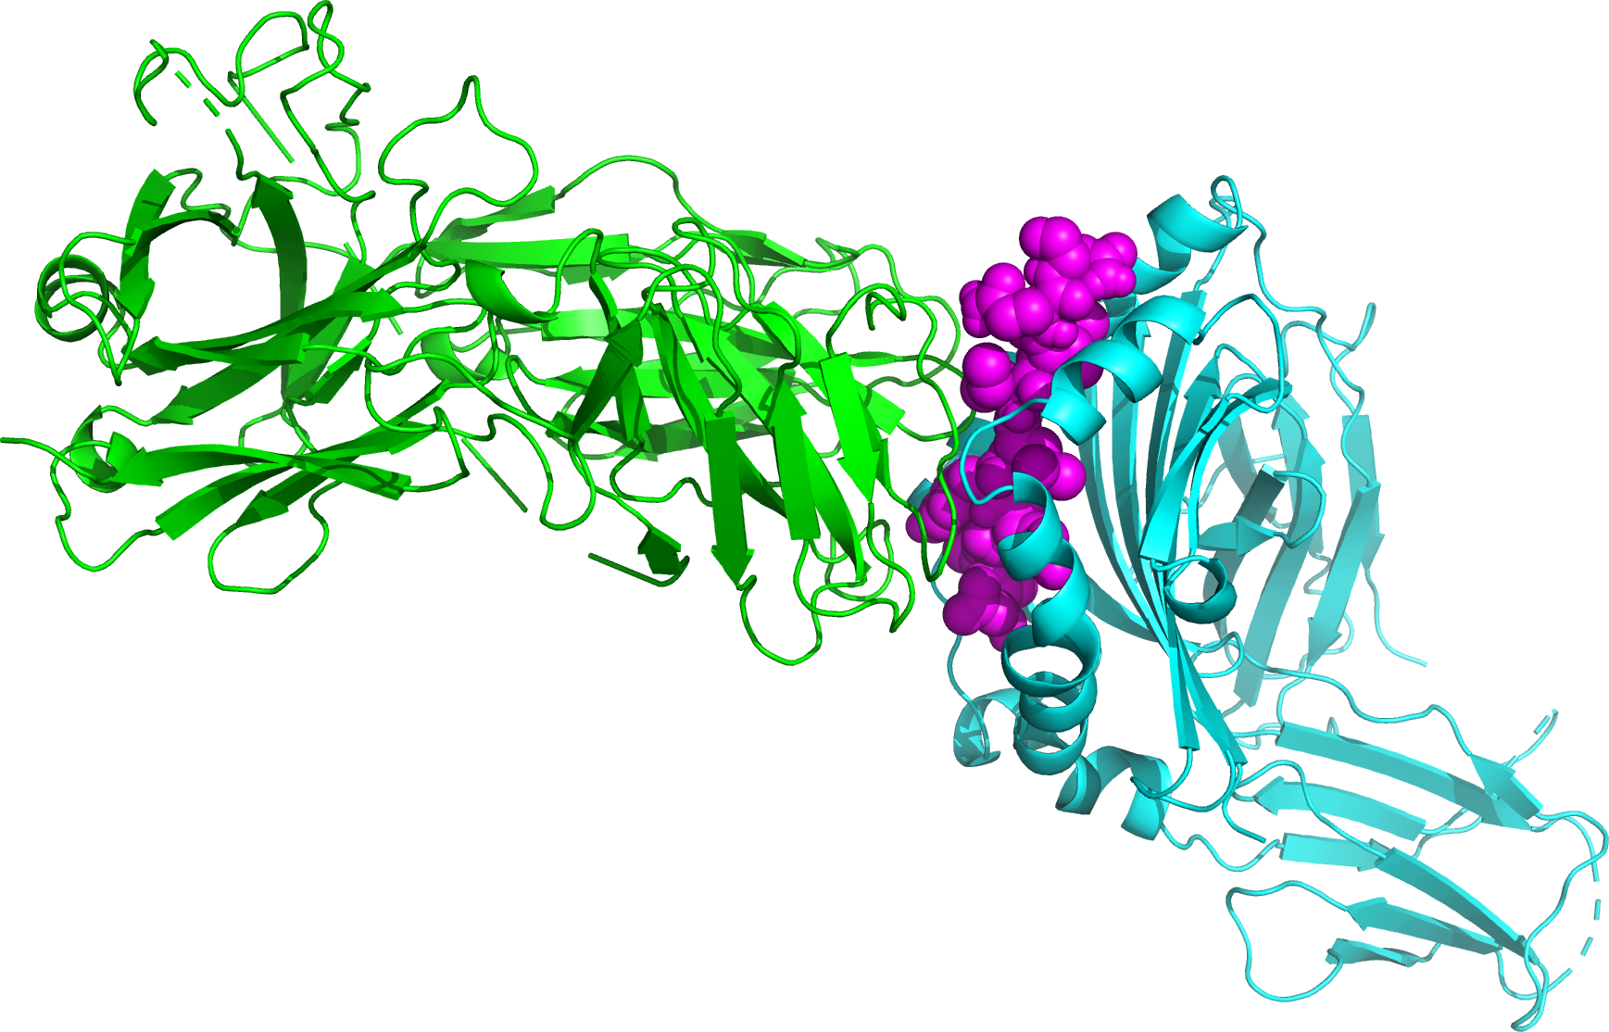
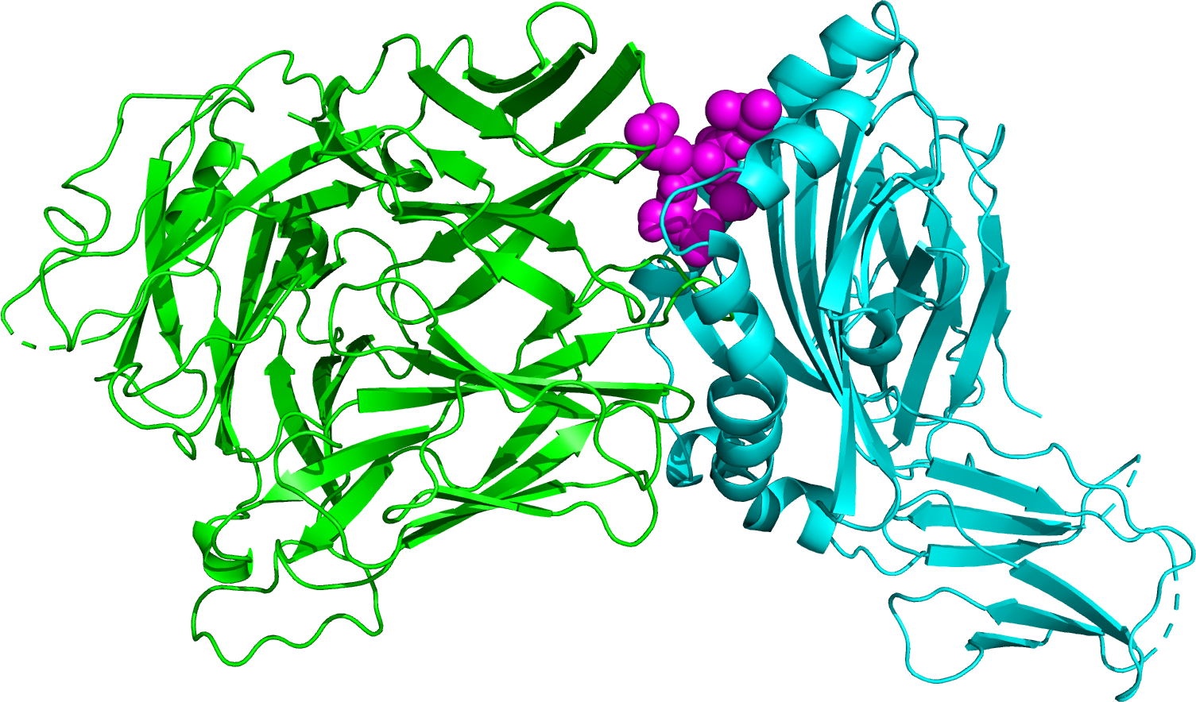
HLA-CSP peptide-TCR Complexes
CSP 3D7 Ref | CSP-1 | CSP-4 | CSP-7 | CSP-8 | CSP-12
CSP-15 | CSP-16 | CSP-19 | CSP-22 | CSP-32 | CSP-35
CSP-47 | CSP-55 | CSP-68 | CSP-94 | CSP-117 | Other Info: CD4+ T Cell HLA-DRB1 Th2R Region

Slide 7
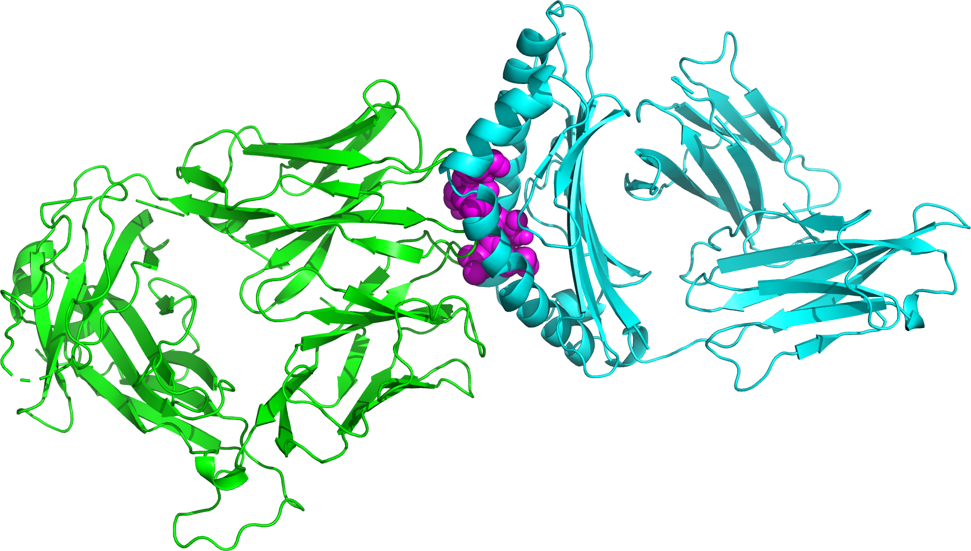
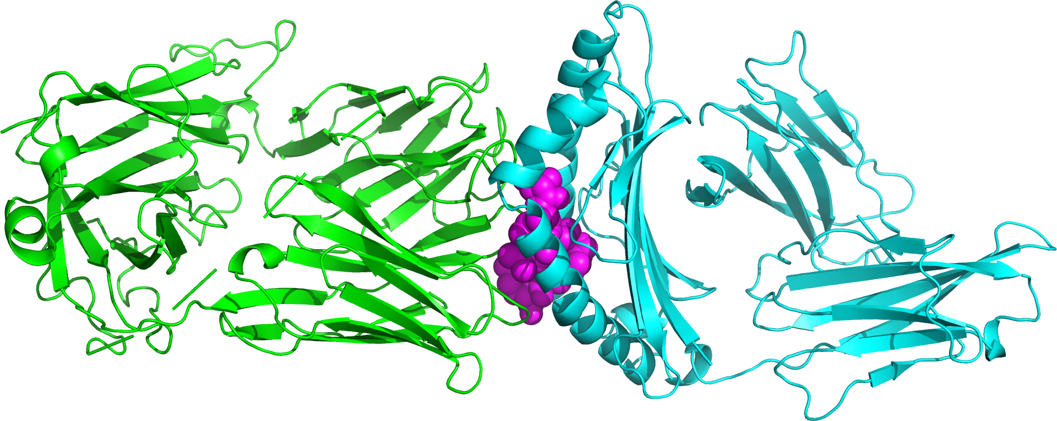
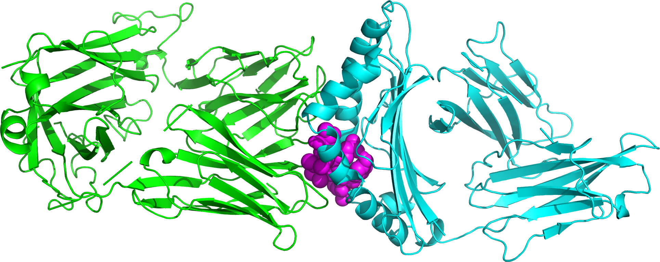
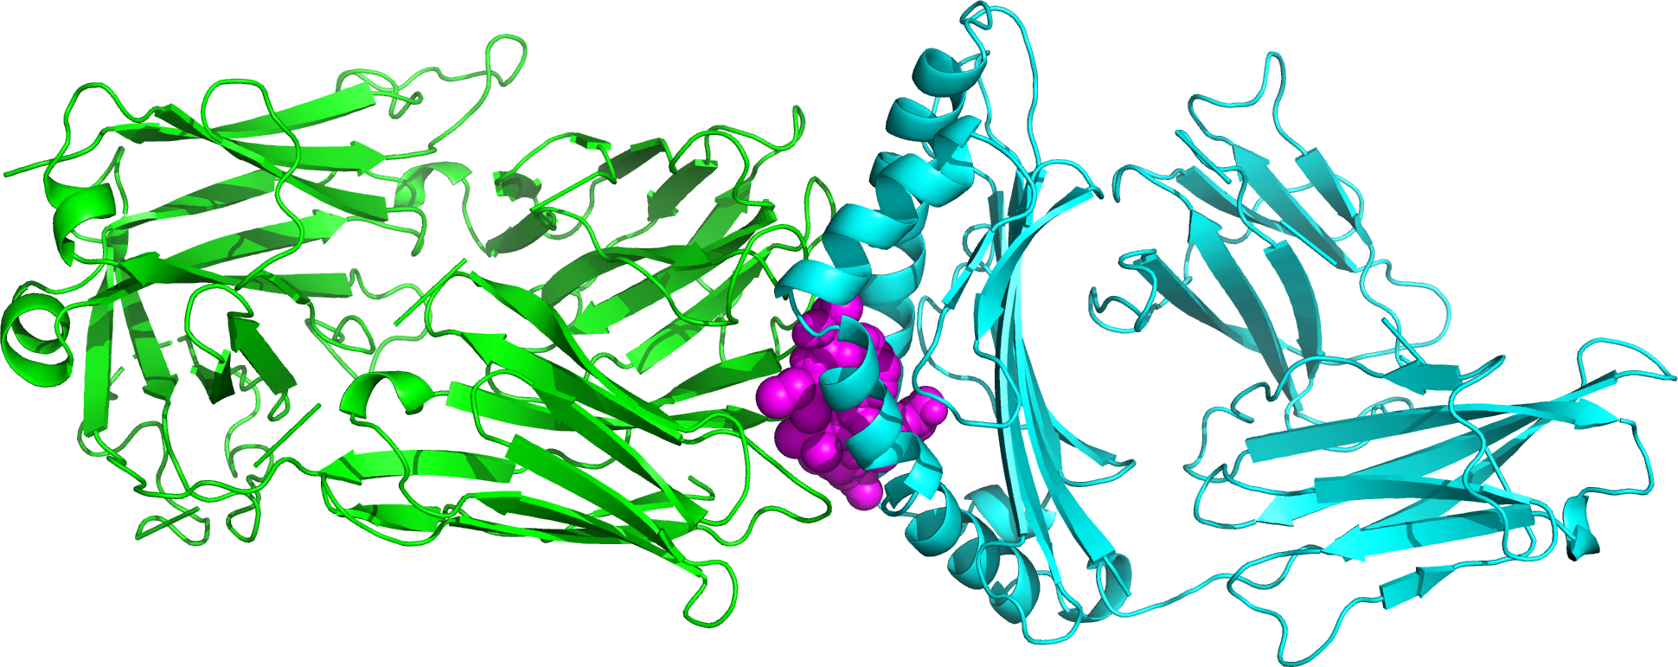
HLA-CSP peptide-TCR Complexes
CSP 3D7 Reference | CSP-1
CSP-4 | CSP-35
Other Info:
CD8+ T Cell
HLA-A2
Th3R Region

Slide 8
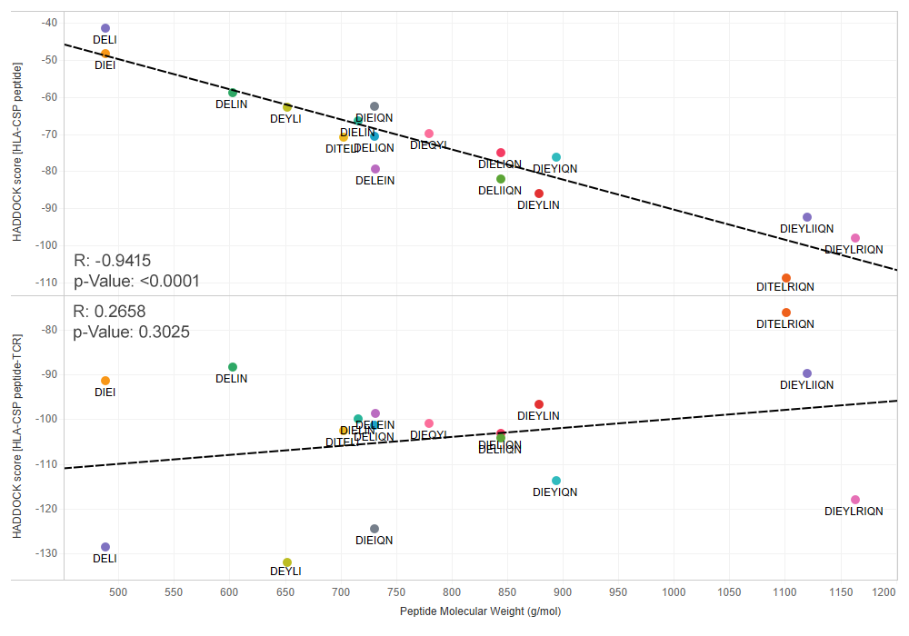
“The Goldilocks Approach”
Pick a common haplotype that renders a medium-sized peptide for optimal binding between the HLA and TCR proteins.
Example:
CSP-35, 39
● DIELIQN
Found in 29% of our samples

